Slide 1

Ppt on MIET HEALTH CARE
Submit To : Ms. Shweta Saxena
Submitted By : Kunal Yadav 2100680100195
Madhur Tyagi 2100680100203

Slide 2

Index
Introduction
Objective
Technology Used
Data Flow Diagram
How it Works

Slide 3

Introduction
We create a website in which we are providing the health and related service and online appointment with doctors.
In this we provided our Specialists and Doctors teams with embedded map in it.
We added Home, Services, Contact Us, Make an Appointment pages.
In this we are using HTML , CSS for the designing of the website .

Slide 4

OBJECTIVE
User get overview of our hospital and its services, using this website the user can easily book an appointment from home instead of standing in lines for long hours.
User don’t have to pay commission to the third-party.
Using this website there is direct interaction between customer and Hospital Staff.

Slide 5

Technology Used
HTML
CSS
The Hypertext Markup Language or HTML is the standard markup language for documents designed to be displayed in a web browser.
It can be assisted by technologies such as Cascading Style Sheets and scripting languages such as JavaScript.
Cascading Style Sheets is a style sheet language used for describing the presentation of a document written in a markup language such as HTML.
CSS is a cornerstone technology of the World Wide Web, alongside HTML and JavaScript.

Slide 6

Data Flow Diagram

Slide 7
User
Home
Services
User will check the services provided by the hospital
Make an Appointment
Contact Us
Send Email or contact to hospital staff
Fill User details to create an Appointment

Slide 8

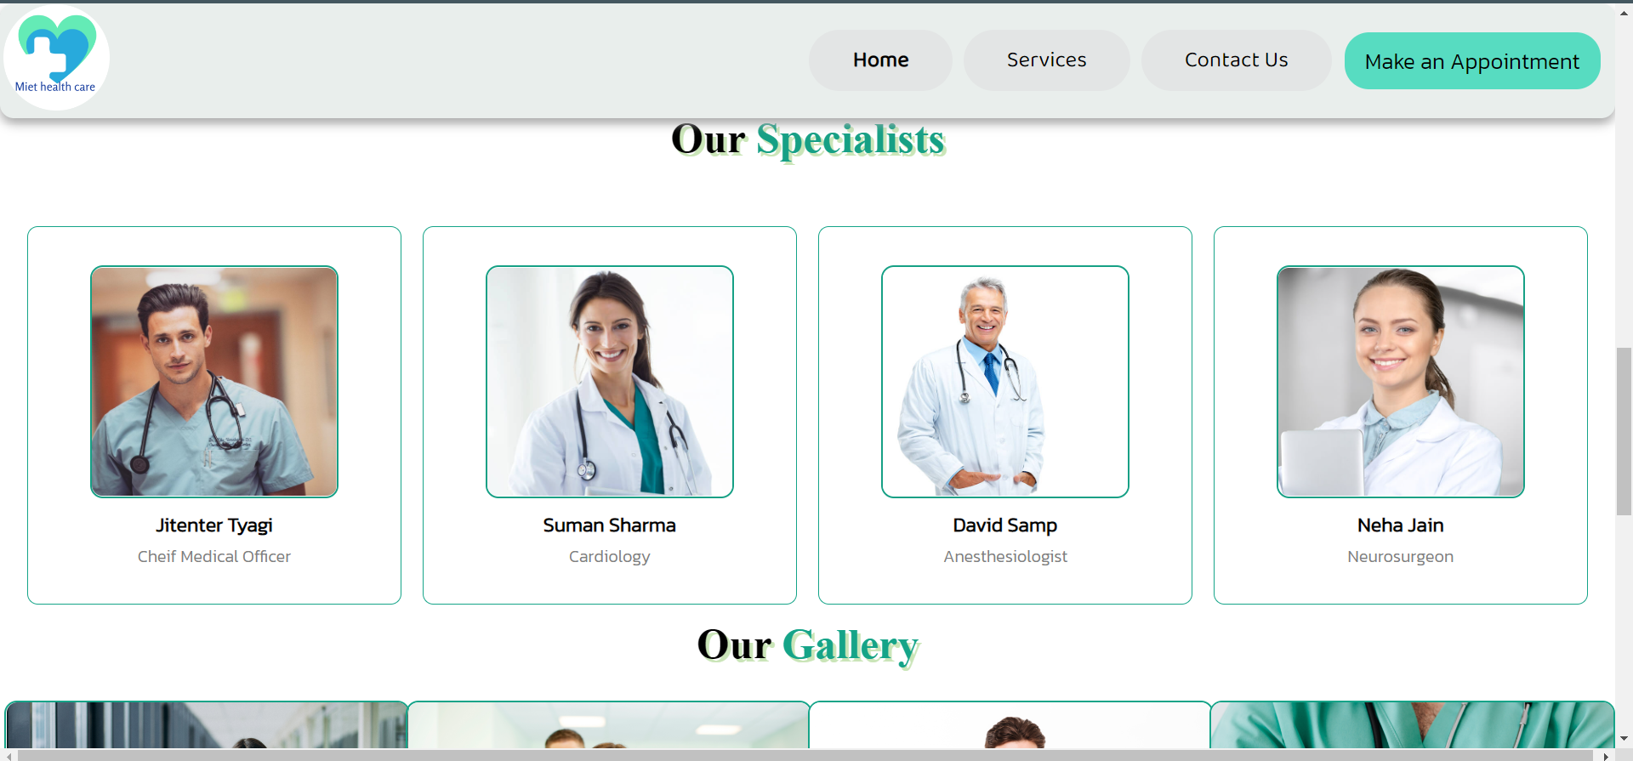
How it works Home Page
This is the front page of our website which shows a navigation bar to the customer from where he can switch to different features of the website .

Slide 9
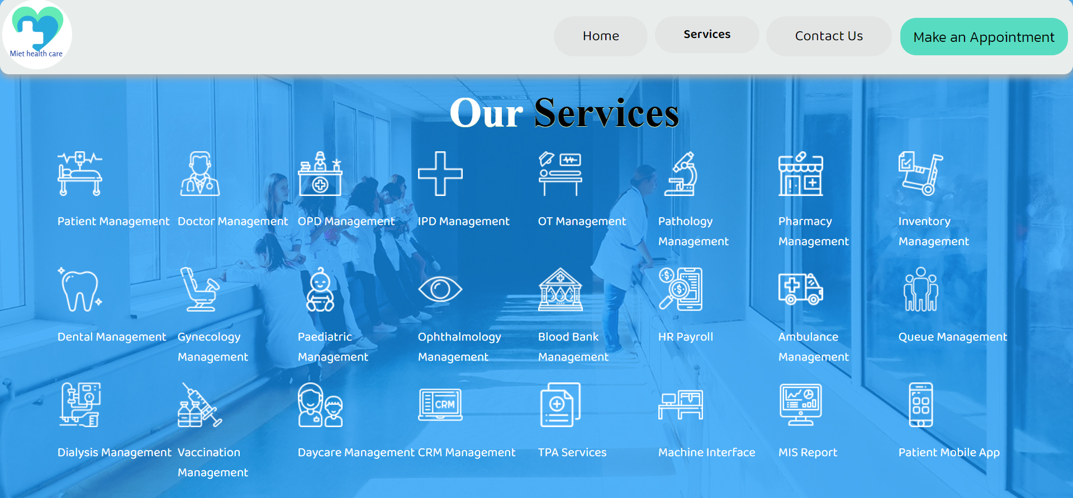
Services
This is the service page of Miet health care in this we describe the services provided by our hospital in a image format in this we use HTML and CSS .

Slide 10
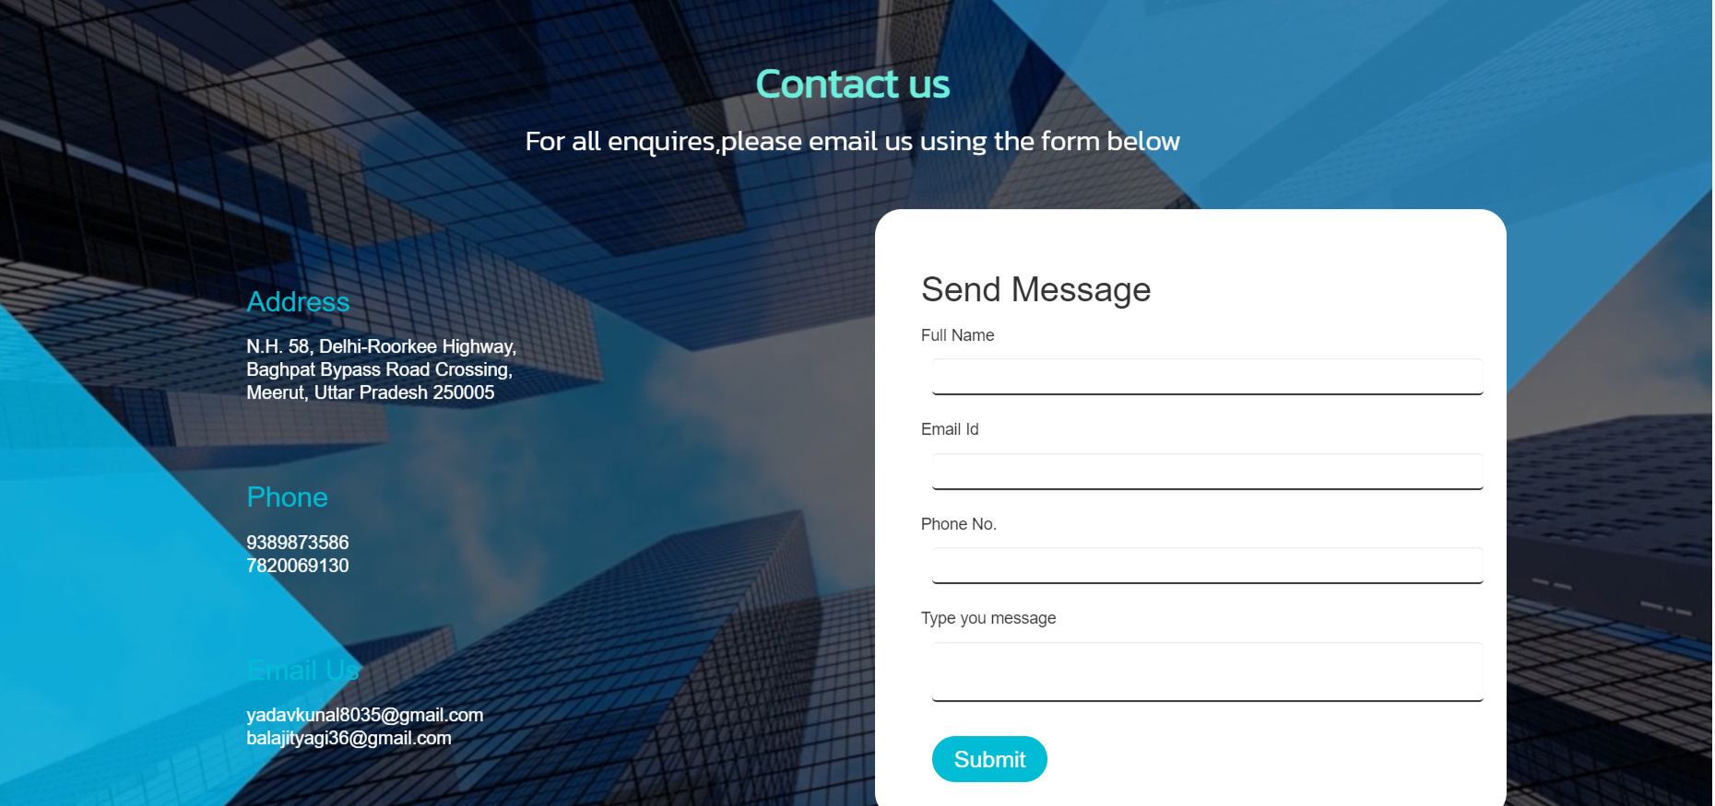
Contact us
This is the contact us page of the Miet Health Care in this if user want to contact with hospital management the user fill the form and describe their problem

Slide 11
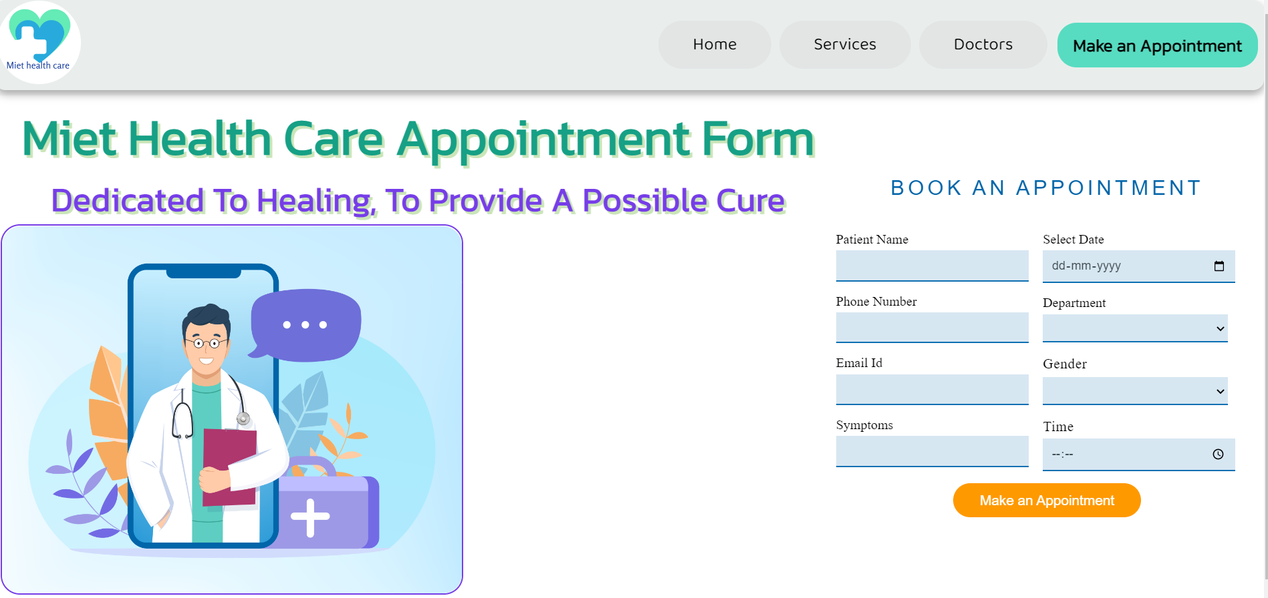
Appointment Form
This is the appointment form of the Miet Health Care in this user book an appointment through filling details like:
Patient Name
Phone Number
Email id
Symptoms
Date
Department
Gender
Time

Slide 12




Thank You
Kunal Yadav (2100680100195)
Madhur Tyagi (2100680100203)

